Slide 1

Job Recruitment System (JRS)
Phase 1 Individual Technical Contribution Report
PRESENTER
INDIVIDUAL ROLE
CORE SCOPE
Zheng Chenjun
Lead UI/UX Designer & Front-End Dev
Aim A: Self-Registration & Account Mgmt

Slide 2


SYSTEM SCOPE & FUNCTIONAL MAPPING
Aim A Core Scope & Contribution Breakdown
Target Scope & Requirements
Personal Contribution (%)
•
Aim A Scope: End-to-end applicant onboarding, self-registration, credential verification, and dynamic profile editing.
Deliverable Section | Contribution (%)
Aim A Figma & UI System | 80%
Front-End HTML/CSS Layouts | 40%
FRS Specification (FR-01 / FR-02) | 30%
3NF Database Schema Alignment | 20%
Project Governance & Slides | 25%
•
FR-01 (Dual-Role Authentication): Defined Role-Based Access Control (RBAC) boundaries separating Candidates and HR personnel.
•
FR-02 (Modular Candidate Profile Store): Engineered structured data schema for Personal Summary, Experience, Education, Certifications, and Skills.
•
Engineering Execution: Maintained visual continuity from Figma design tokens directly into Flexbox layouts and 3NF relational database tables.

Slide 3
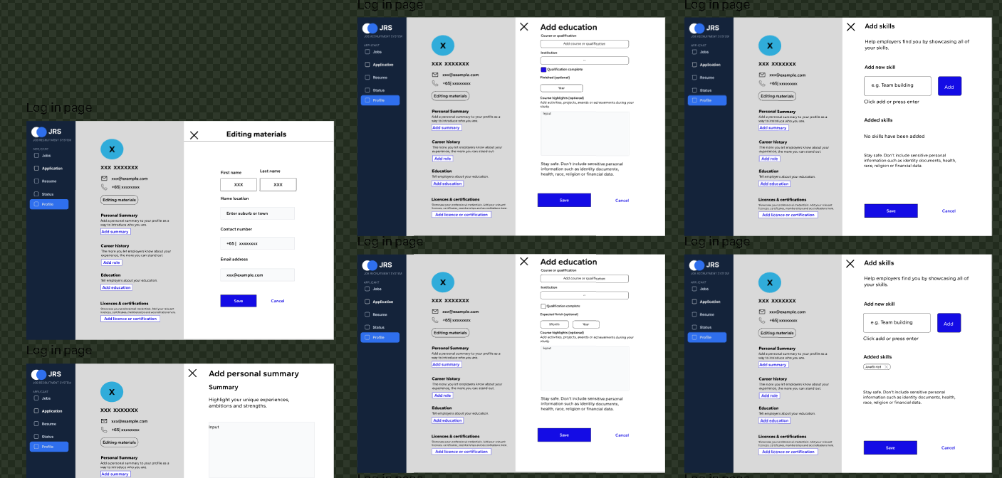



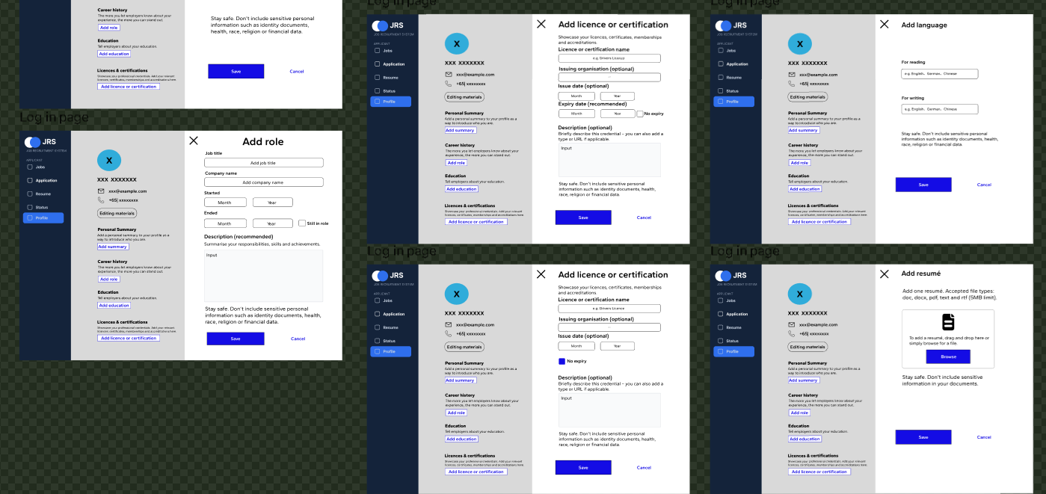
HCI & PROTOTYPING ARCHITECTURE
High-Fidelity UI Prototyping (Figma)
Design System Highlights
•
Desktop Viewport Layout: Two-column dashboard with a fixed dark navigation sidebar and structured content cards.
•
Interactive Modal Overlays: Designed modal states for adding education, career history, skills, and resume attachments without page navigation.
•
Figma Auto-Layout 5.0: Enforced flexible spacing tokens and component state variants (Hover, Active, Default).
•
Single Source of Truth: Served as the visual contract for backend developers to verify input field requirements.
Figure 1: High-Fidelity Figma Design System
Interactive wireframes and component layouts designed for Aim A (Applicant Portal & Registration Modals).

Slide 4
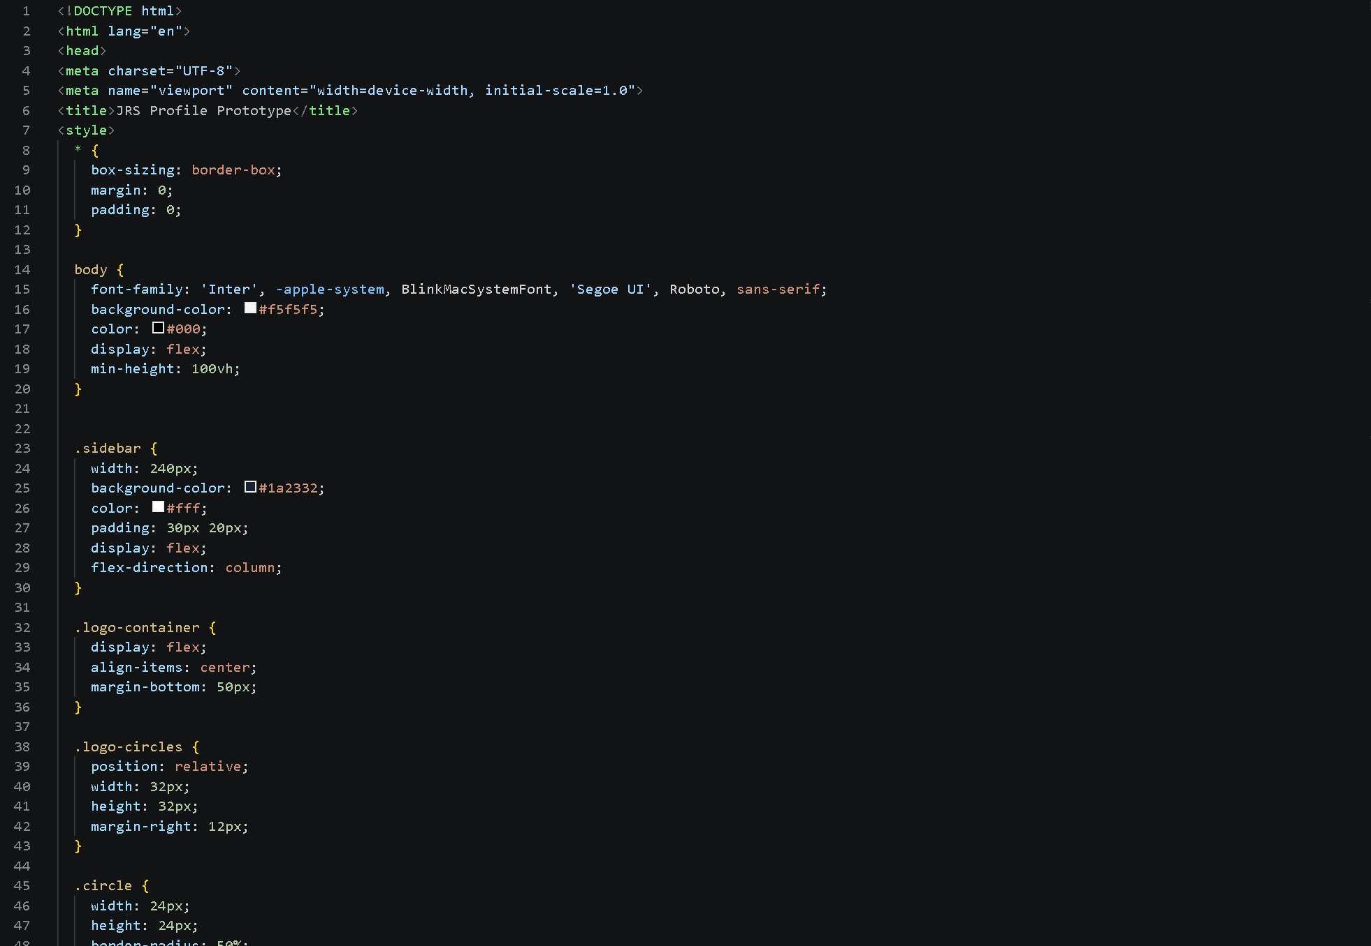

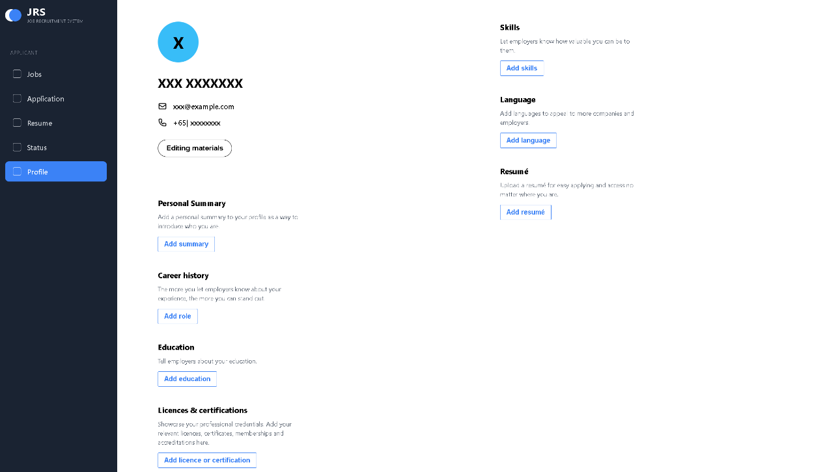

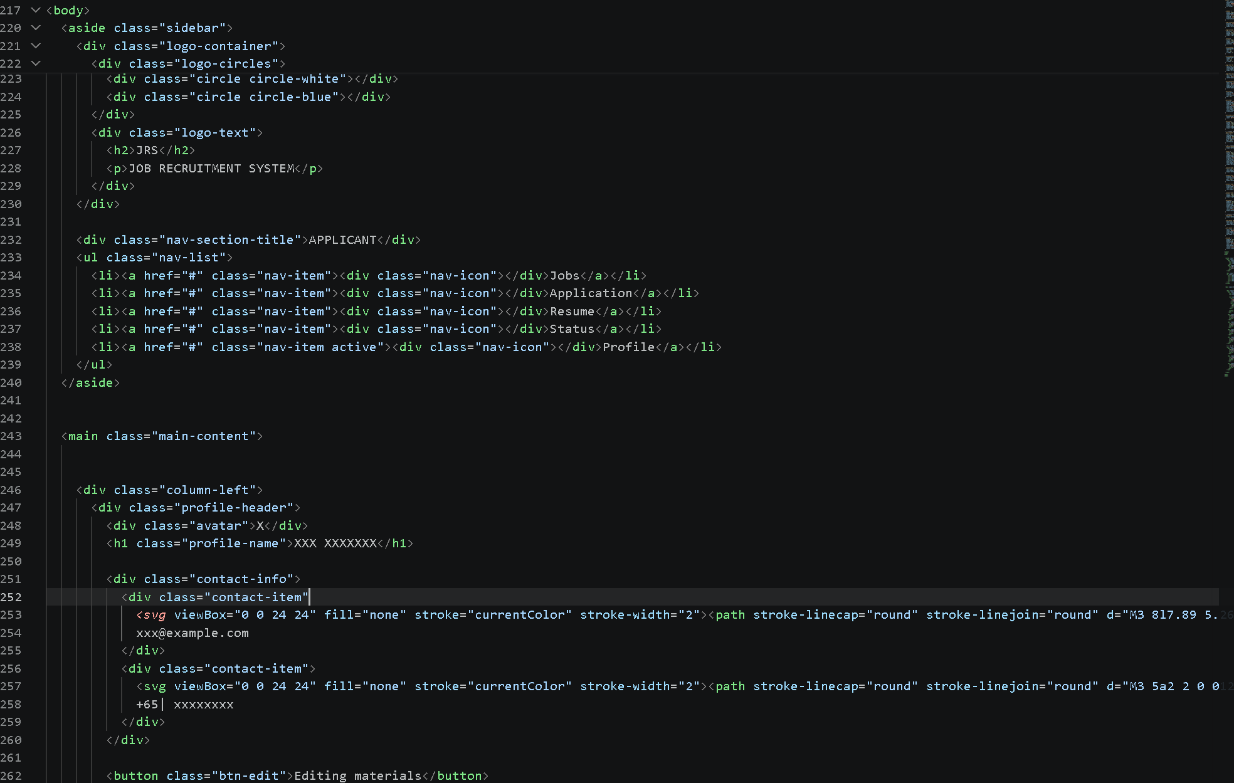
FRONT-END ENGINEERING
HTML5/CSS3 Web Page Translation & Codebase
Figure 4: HTML5 & Flexbox Codebase
Underlying HTML markup and modular CSS Flexbox layout logic pushed to GitHub.

Slide 5
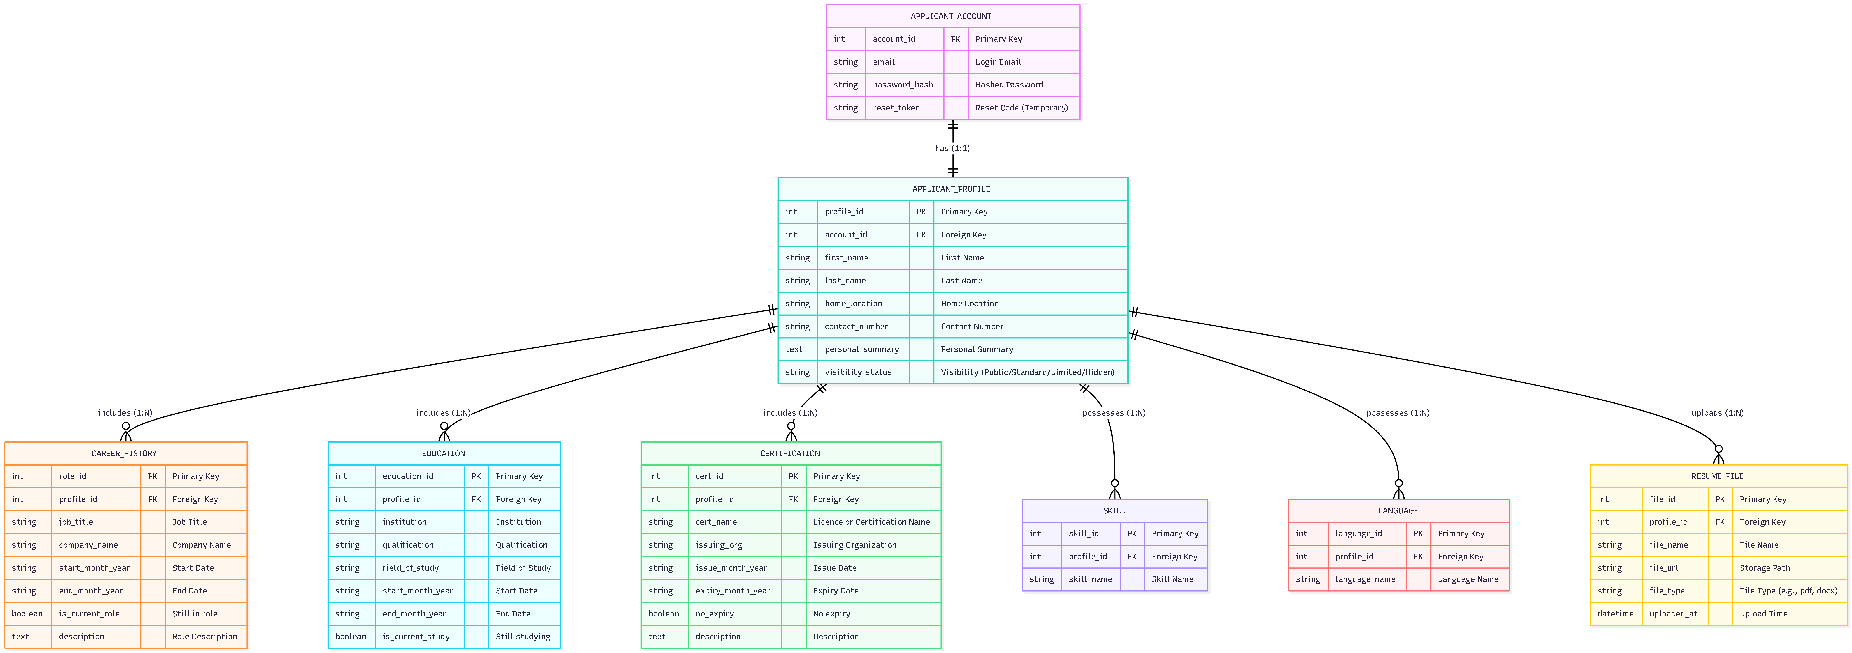
DATABASE & GROWTH ROADMAP
3NF Schema Alignment & Skill Development
Self-Directed Learning
Part A Achievements:
• Figma Auto-Layout & Component Variants
• Responsive CSS Flexbox Container Logic
• 3NF Relational Database Mapping Rules
Part B Planned Growth:
• RESTful API Integration (`Fetch API` / Async JS)
• Dynamic Client-Side State Handling
• Input Sanitization (XSS & SQLi Defense)

Slide 6





GOVERNANCE & DELIVERY
Team Collaboration & Delivery Summary
100% Attendance
WBS Schedule Control
Early Quality Delivery
Maintained a 100% attendance record across all scheduled bi-weekly supervisor progress meetings and bi-weekly internal team syncs.
Tracked individual tasks weekly against our Work Breakdown Structure, preventing deadline bottlenecks and ensuring steady milestone progress.
Delivered Figma specs and HTML skeletons 2 to 3 days ahead of team review dates, providing buffer time for database schema cross-validation.

